Slide 1
Problems on Energy and Power Signals
Signals and Communication Systems (SCS)
Session-6

Slide 2



Problems on Energy and Power Signals
The value of power of given signal does not depend on frequency and phase components of the signal.
The value of power depends on scaling in amplitude and squaring (or higher powers) of the signal. However, the value of power does not depend on scaling in time (compression, expansion).
The value of energy does not depend on shifting, folding and combined shifting and folding of the signal.
However, the value of energy depends on scaling in time (compression, expansion) and amplitude and squaring of the signal.

Slide 3
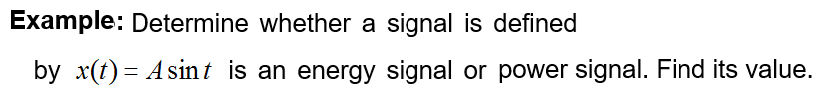

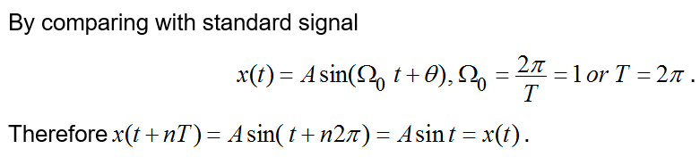
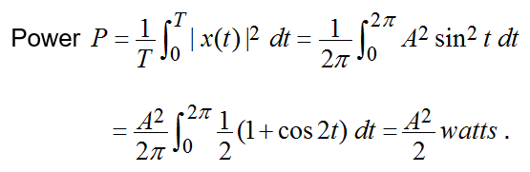

Slide 4
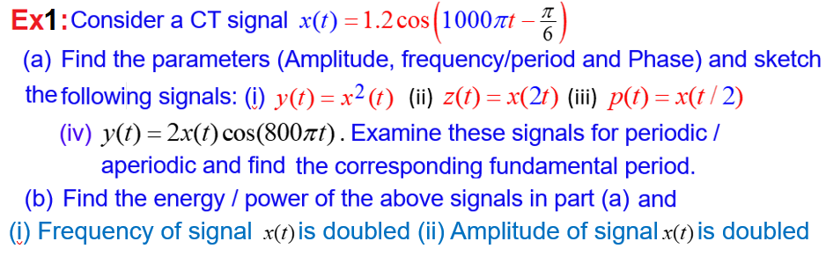
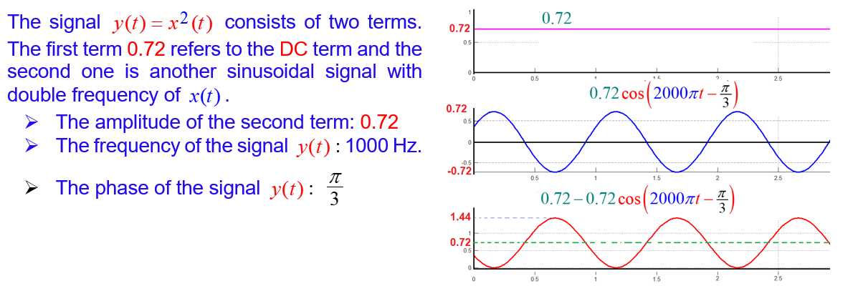

Slide 5
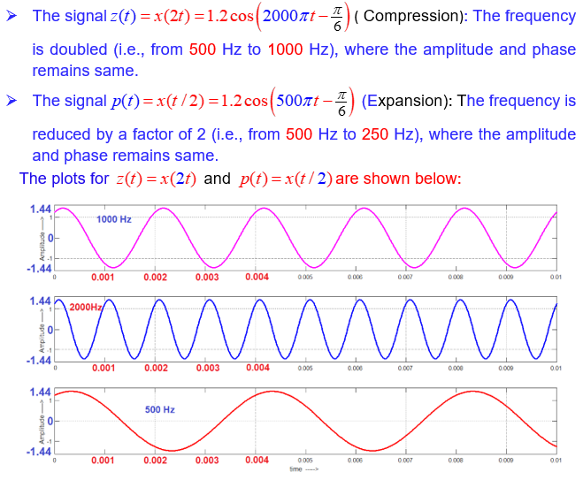

Slide 6
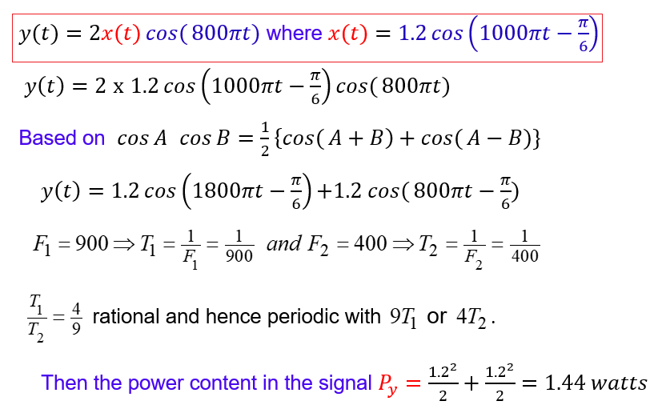

Slide 7
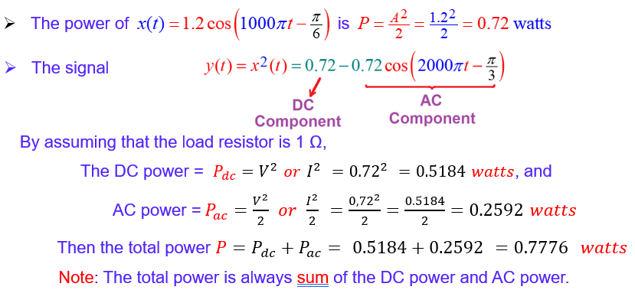
Power: Power depends only on amplitude, but not on frequency and phase

Slide 8
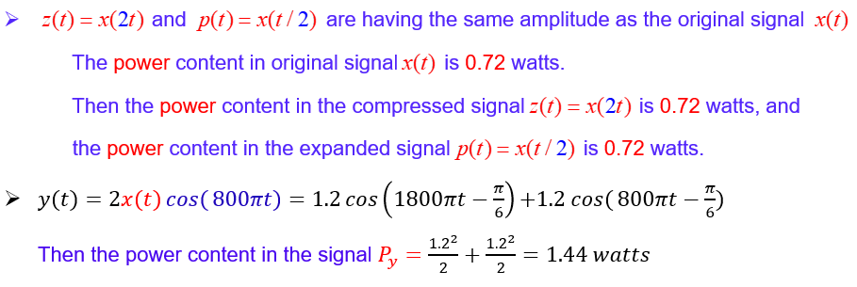
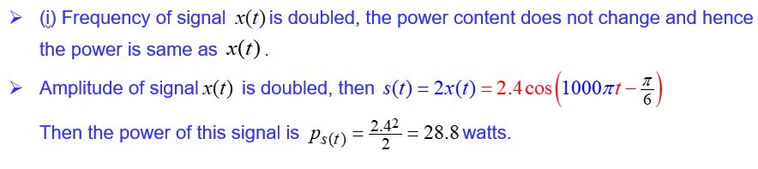
Power:

Slide 9
End

